Slide 1
TASK 4 : System Modelling and Design
PRESENTED BY
ETHE ENAME (SENG22SE015)
ETIKWE RAMPSON (SENG22TE004)
AGBOR AYAMBA (SENG22TE002)
COURSE TITLE: Internet Programming
&
Mobile Programming
COURSE INSTRUCTOR: DR VALERY NKEMINI

Slide 2
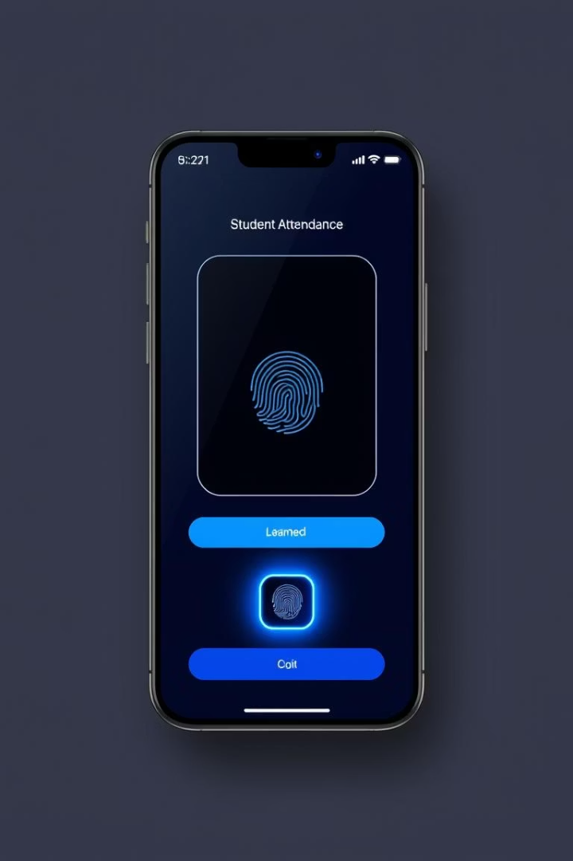
Biometric Student Attendance App: System Modelling & Design
This presentation covers key system design diagrams for a biometric student attendance app. It addresses the application's structure and interactions crucial for implementation and clarity.

Slide 3
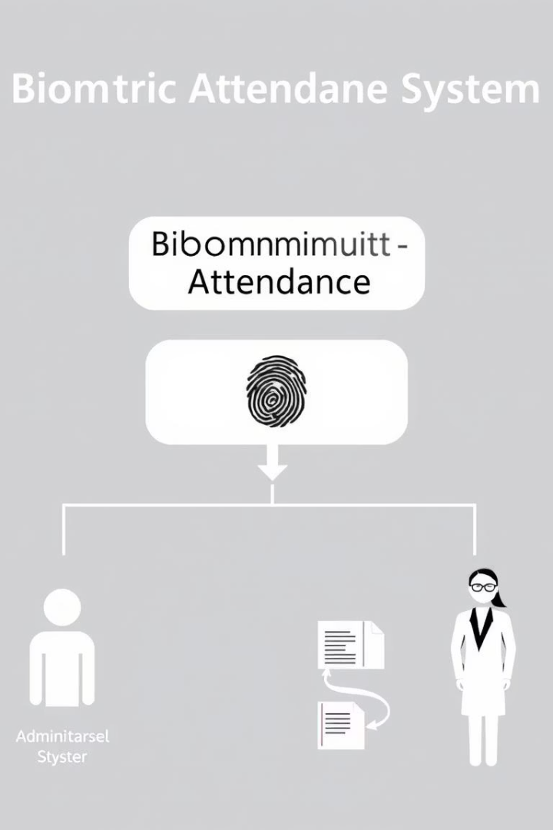
Context Diagram Overview
Purpose
Key Elements
Visualize the system boundary and external entities.
Biometric Attendance System
Students
Teachers
Admin
Database
Focus
Identify data exchange between system and actors.

Slide 4
Dataflow Diagram (DFD)
Processes
Data Stores
Capture Biometric Data
Student Records
Verify Identity
Attendance Logs
Record Attendance
Biometric Templates
Generate Reports

Slide 5

Use Case Diagram
Students
Teachers
Admin
Mark attendance using fingerprint scanner
View attendance reports and approve records
Manage user profiles and system configuration

Slide 6
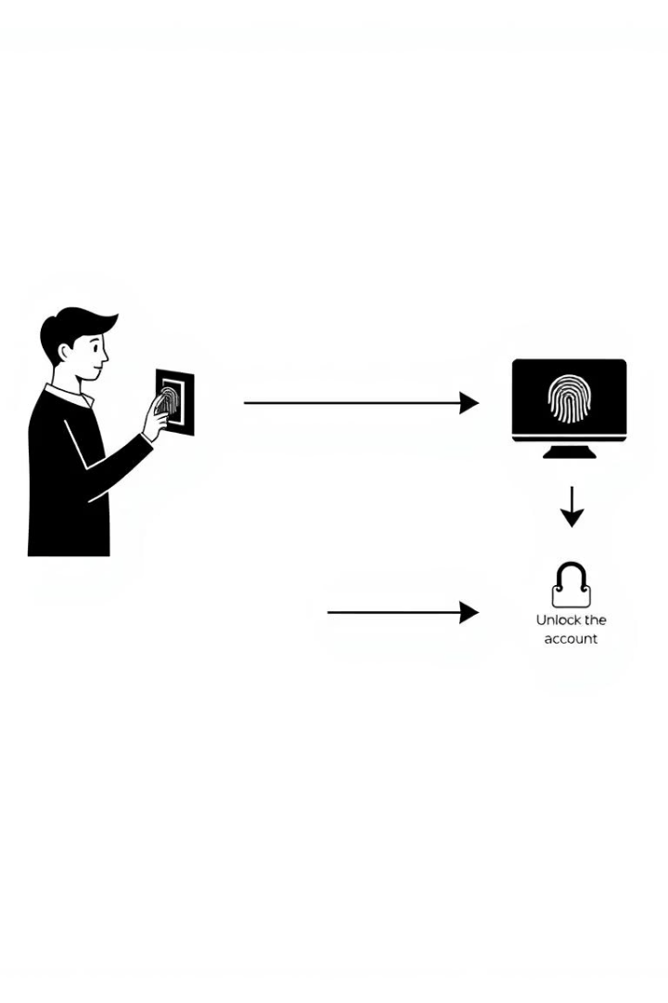




Sequence Diagram
Student Scans Fingerprint
System Captures and Processes Data
Verify Biometric Match
Record Attendance

Slide 7
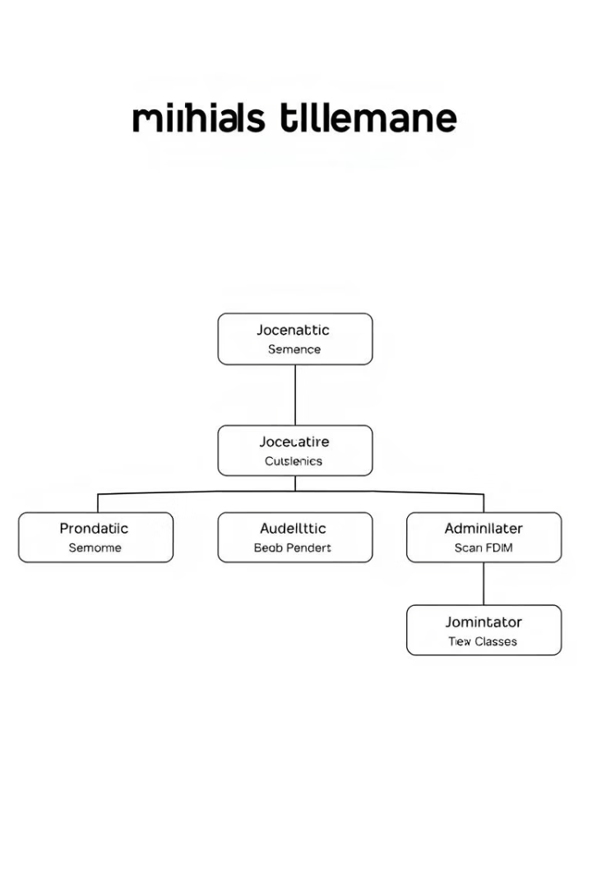
Class Diagram
Key Classes
Student
FingerprintTemplate
AttendanceRecord
Admin
SystemController
Responsibilities
Manage biometric data
Authenticate users
Log attendance
System configuration

Slide 8
Deployment Diagram
Hardware
Network
Biometric Scanner Devices
Connects devices securely with data encryption
Application Server
Supports real-time data synchronization
Database Server
Admin Workstation

Slide 9
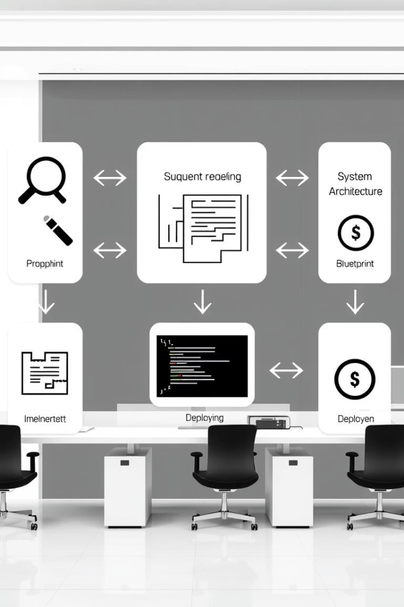
Summary and Next Steps
Review System Models
Develop Prototype
Build initial app and simulate biometric attendance functionality.
Ensure alignment with app requirements and stakeholders.
Iterate Design
Refine models based on test results and feedback.

